Slide 1

DataStar: Machine Learning Rishwaraj G.

Slide 2
Modules
Introduction
Regression
Classification
Regularization Techniques & Cross-Validation
Machine Learning Algorithms
Ensemble Methods
Introduction to Unsupervised ML
Dimensionality Reduction Techniques
Clustering Techniques
10. Introduction to Natural Language Processing

Slide 3

What is Machine Learning?

Slide 4



Machine Learning
Giving computers the ability to learn from data

Slide 5
Data
Today: Large amounts of data everywhere
Data
Structured
Unstructured
Machine Learning
Data-driven
Capture knowledge in data to improve model performance

Slide 6
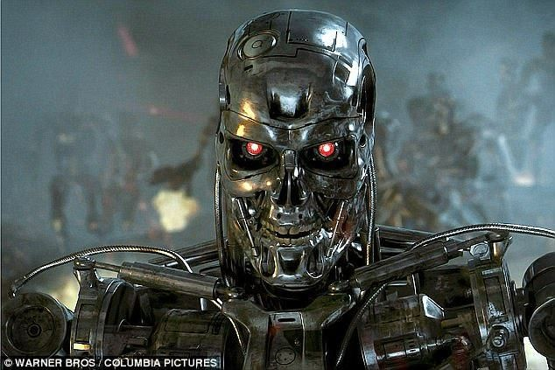
Machine Learning
Thanks to Machine Learning:
Email spam filter
Speech recognition and translation
Face and fingerprint recognition for smart home security
Web search engines
Challenging computer chess players
And soon….safe and efficient self-driving cars!
Notes:
https://youtu.be/f_uwKZIAeM0
Question=https://youtu.be/Y07O7KZ6J1c

Slide 7
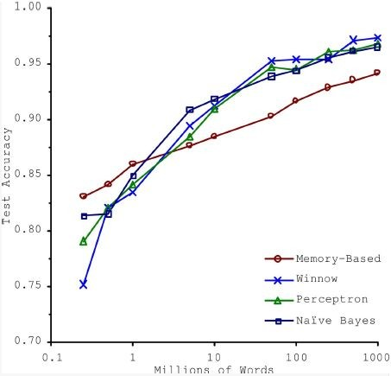
More Data? More Learning?
“The Unreasonable Effectiveness of Data”, by Peter Norvig et al. Google
In a study by Microsoft: “these results suggest that we may want to reconsider the trade-off between spending time and money on algorithm development versus spending it on corpus development.”

Slide 8
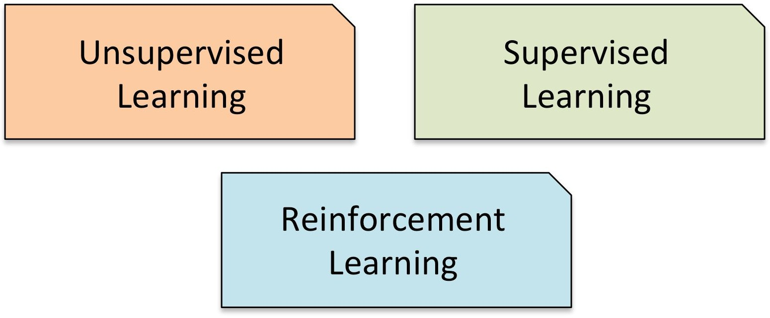

Machine Learning
3 common types of Machine Learning
Notes:
Machine learning is all about building models.
Finding out the logic or the mathematics behind the observations.

Slide 9
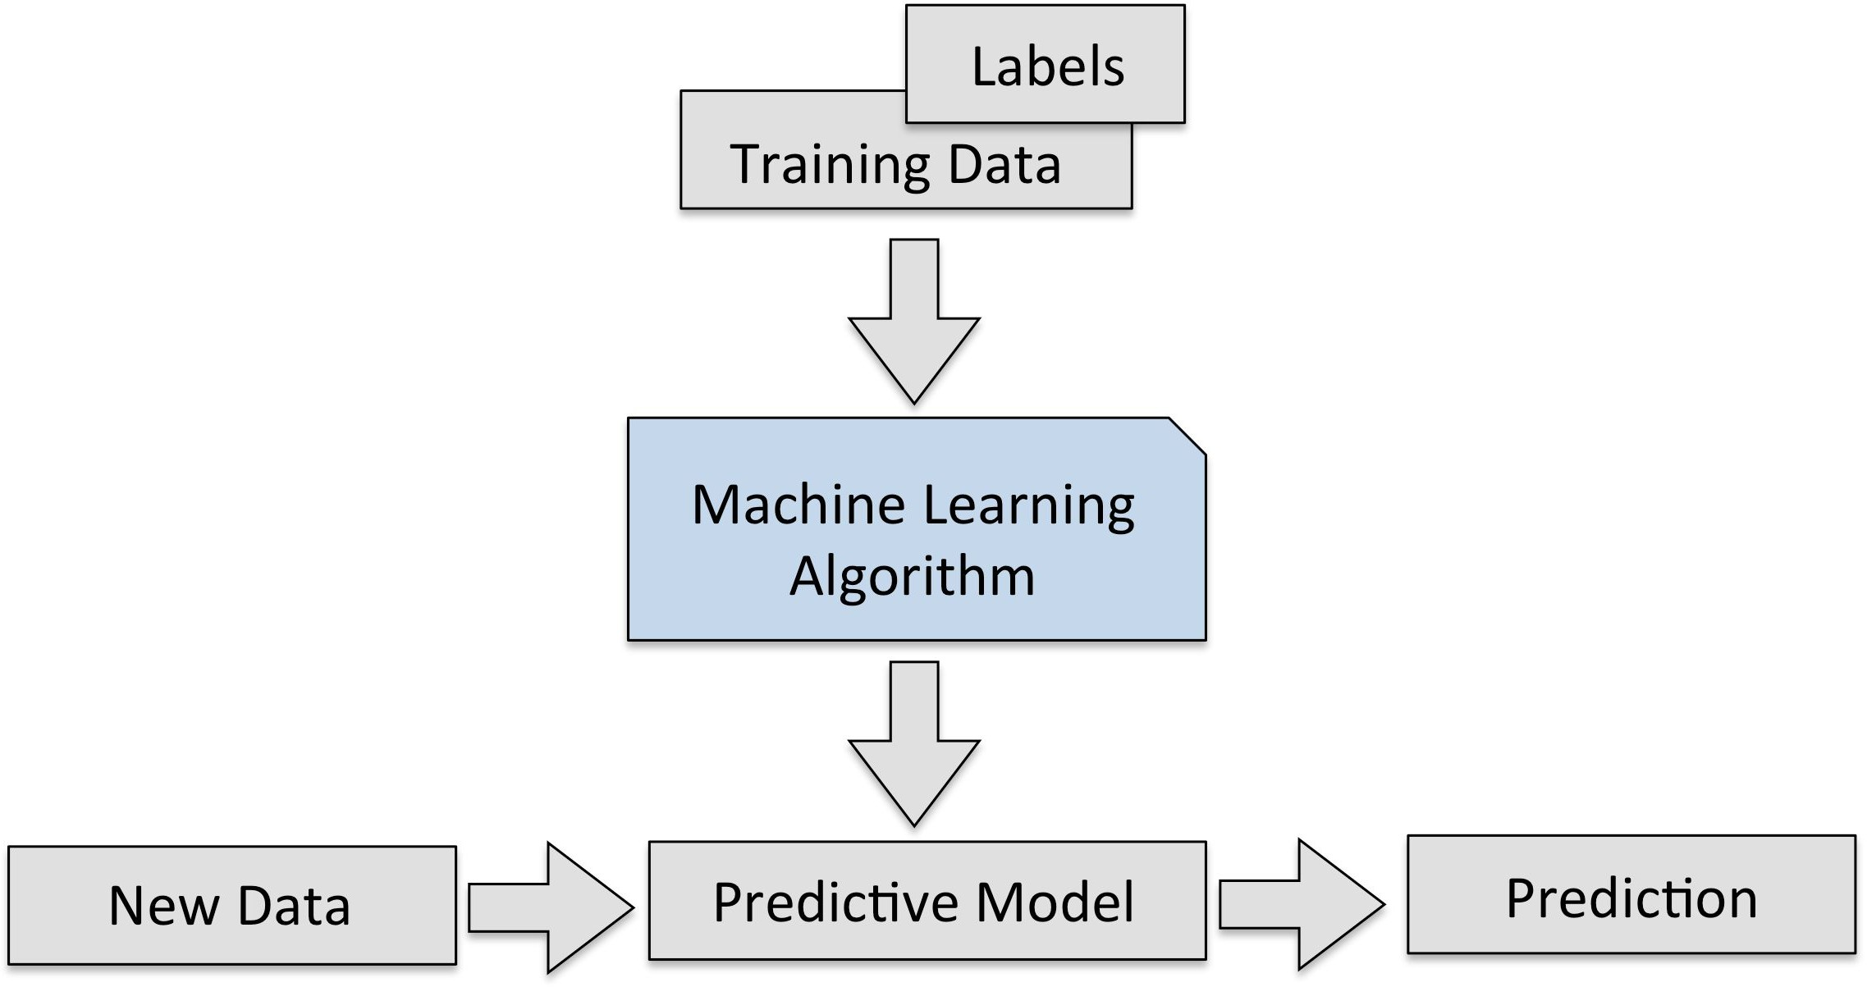
Supervised Learning
Making predictions on unseen / future data
Use labels during training
Classification
Regression
Task Driven!

Slide 10
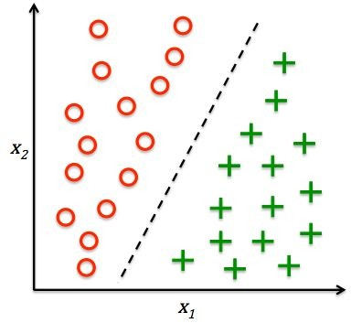
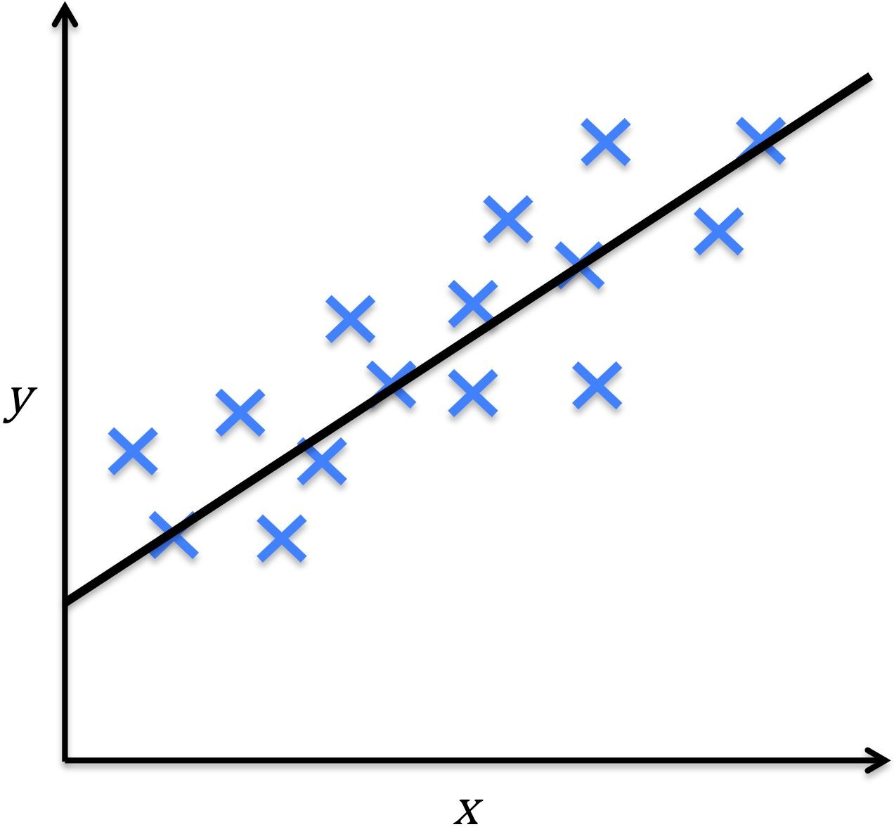
Supervised Learning
Supervised learning tasks
Finds a boundary that best separates the classes
Fit a function that best describes data
Classification
Regression
Notes:
Supervised learning with question=https://youtu.be/DU3ZYWWpFDc

Slide 11
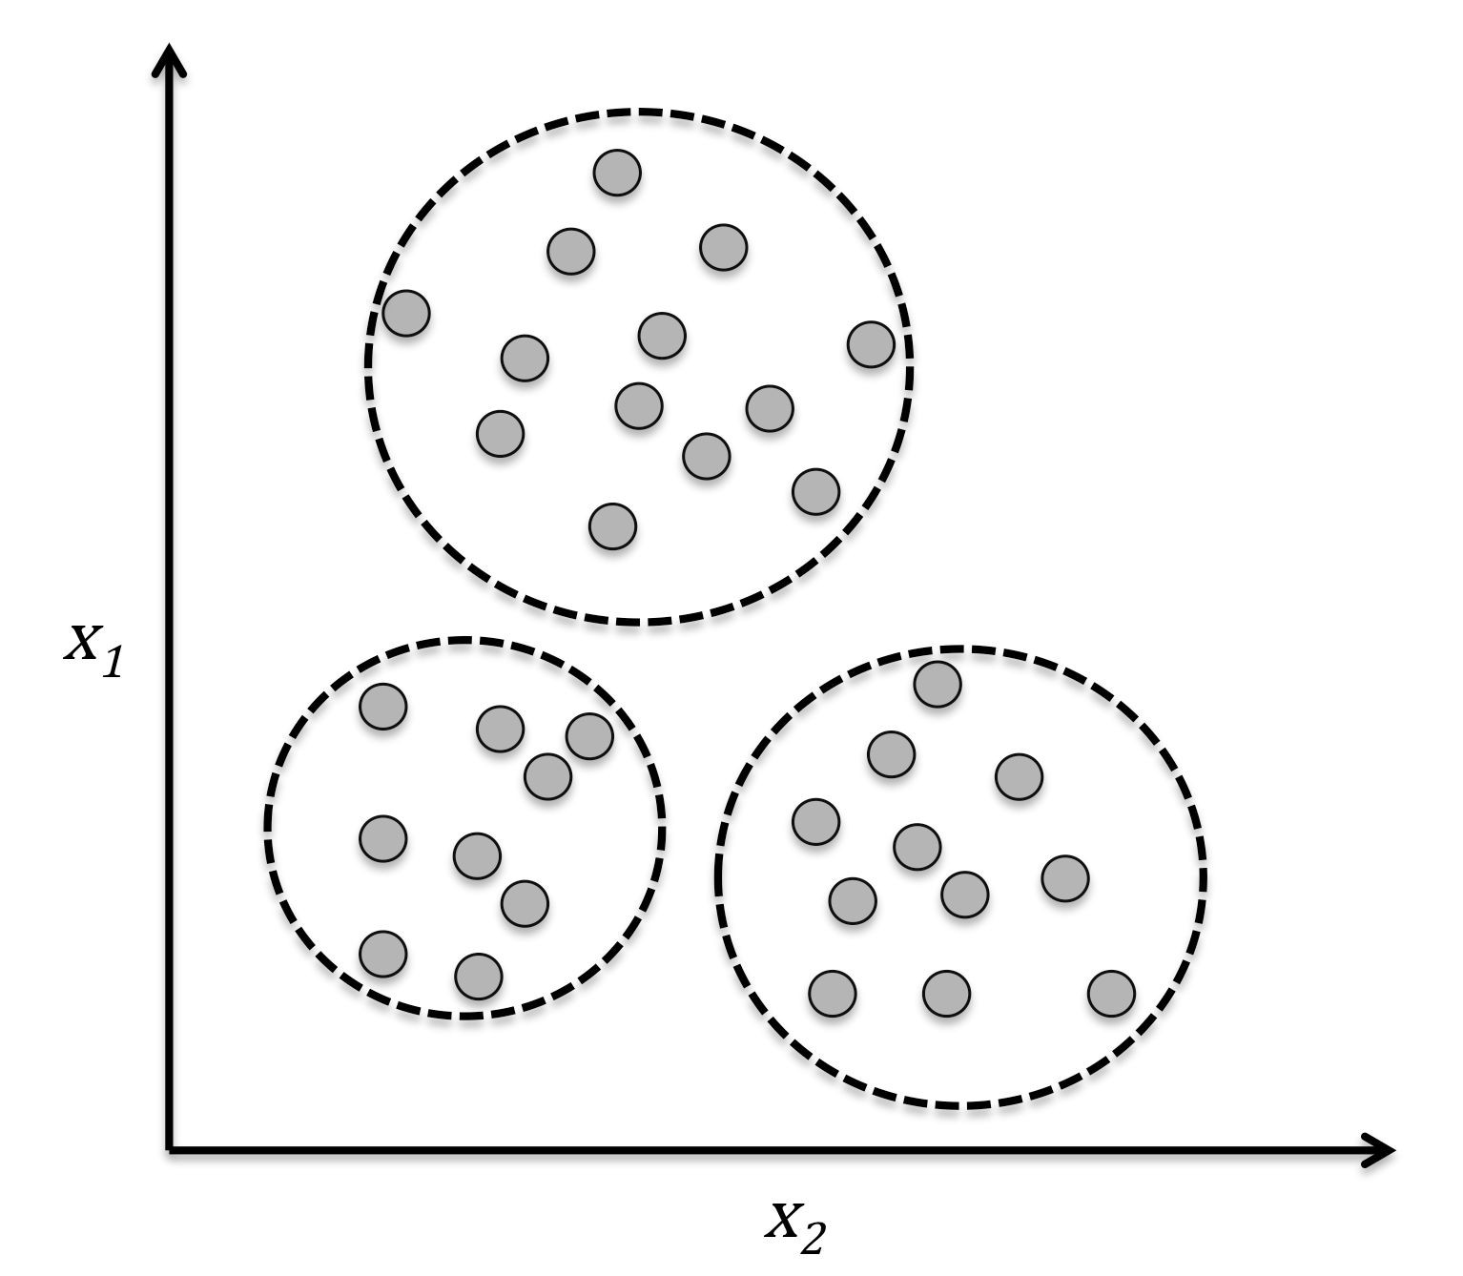
Unsupervised Learning
Discover hidden structure of data without guidance of outcome
No labels were used!
Clustering Organizing data into meaningful sub-groups
Data Driven!
Notes:
Unsupervised learning=https://youtu.be/QEuGkcpa1Tw

Slide 12
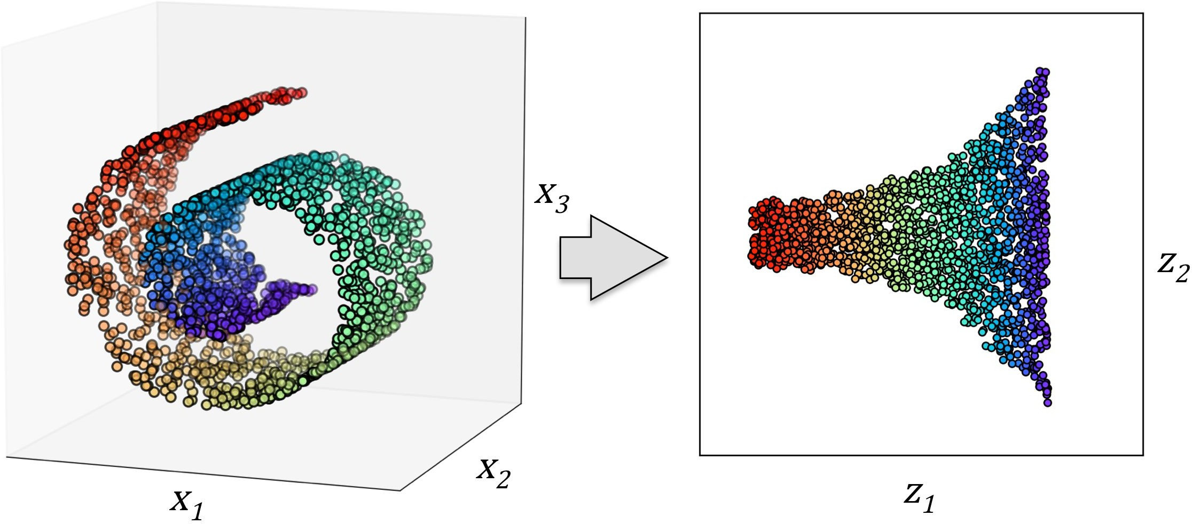
Unsupervised Learning
Dimensionality reduction for data compression
Dimensionality Reduction Feature preprocessing, data compression, data visualization
Notes:
Example=highly correlated features like length in cm or inches

Slide 13
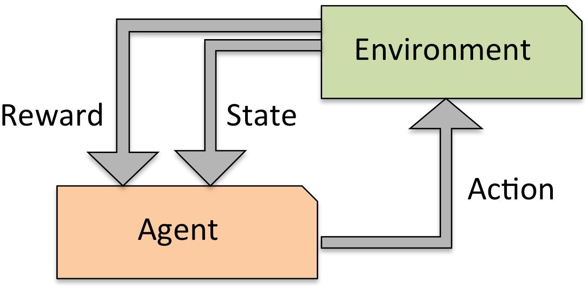
Reinforcement Learning
System that improves performance based on interactions with the environment
No correct label or value, but a reward is used
Reward function: A measure of how well the agent performed the action(s)
Reward Driven!
Notes:
Reinforcement learning=https://en.wikipedia.org/wiki/File:Reinforcement_learning_diagram.svg

Slide 14

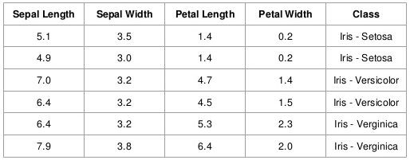
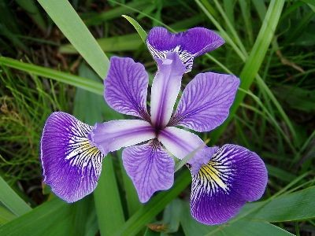
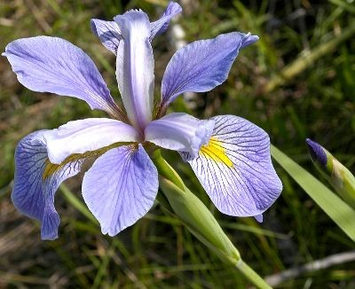
Basic Terminology
4
Features (attributes, measurements,
dimensions)
3
Class labels (targets)
Example: Iris Dataset
Samples (instances, observations)
150

Slide 15
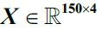
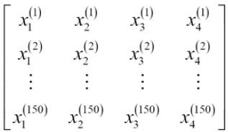
Common Notations
Standard matrix / vector notation for data
Data with 150 samples and 4 features:
A 150 ⨉ 4 matrix:
Denoted by
Example: Iris Dataset
Subscript (i) refer to i-th training sample
Subscript (j) refer to j-th feature dimension

Slide 16
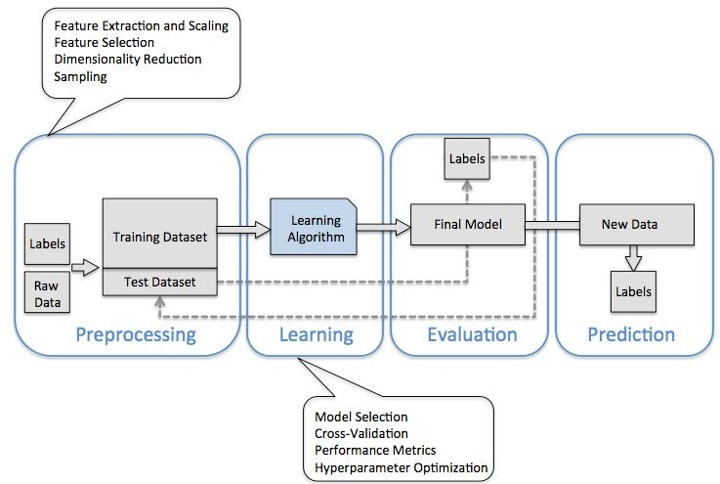
Machine Learning System
Example: Predictive task (classification)
Notes:
http://online.juristechnologies.com/JCOM/login.php
Sampling = https://youtu.be/pTuj57uXWlk

Slide 17
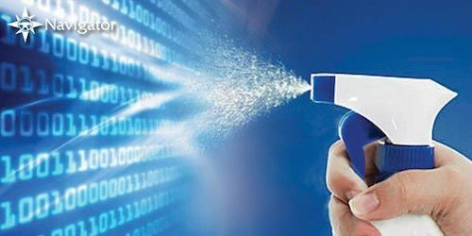
Preprocessing
Getting data into shape
Raw data is not well formed, not suitable for machine to learn
Data cleaning:
Fill missing data, remove outliers
Normalization of features (necessary sometimes)
Features may be highly correlated and redundant ⇒ Dimensionality reduction

Slide 18
Partitioning Data for Training
Data needs to be set up to learn a model
Divide the dataset into separate training and test sets
Training set optimizes the machine learning model
Test set is used to evaluate the model with unseen data
Validation set is used (sometimes) for tuning hyperparameters
Training Set
Test Set
Training Set | Valid. Set | Test Set
Data
Notes:
Overfitting=https://youtu.be/ISV-xZK8PlM

Slide 19
Learning and Evaluation
“No Free Lunch” Theorem
Each algorithm has its biases, no model enjoys superiority if we don’t make assumptions
Cross-validation - validation subsets used to estimate generalization performance of model
Decide on how to measure performance of model
Accuracy, mean square error, etc.
Notes:
No Free Lunch= each algorithm is good in what it is good at
Human good in generalize learning but not commuter algorithm
Mean square=regression
Accuracy=classification

Slide 20
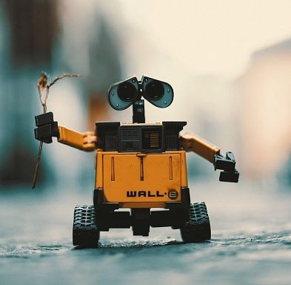
Deploy
After selecting the trained model, use test data to estimate generalization error (test error).
Deploy model to predict new, future data
Important to apply similar procedures (feature normalization, dimensionality reduction) to new data

Slide 21
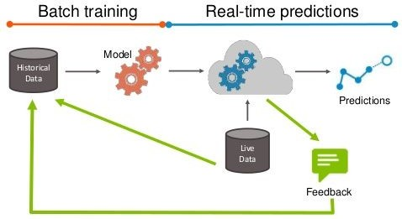
Machine Learning in Production
Notes:
Can again show mindcraft

Slide 22
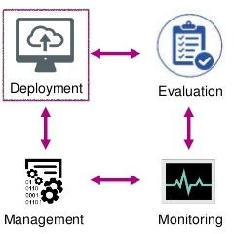
Lifecycle of ML in Production

Slide 23

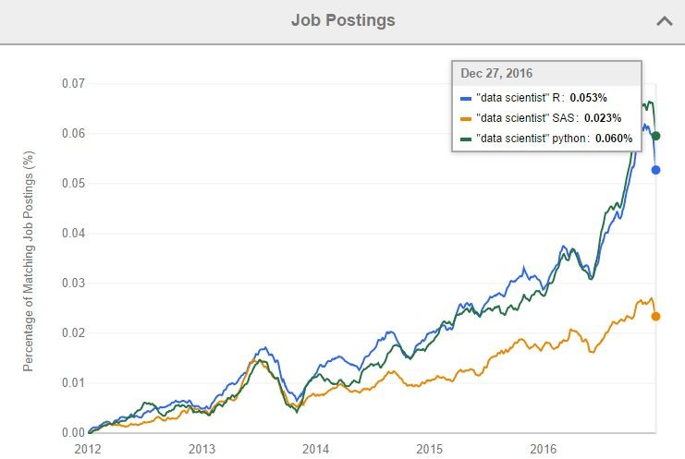
Using Python
One of the most popular programming languages for data science (#1 in 2017)
Allows direct interaction with code
Large number of useful libraries
Growing ecosystem - support for web services, interfaces, data management
Great for computationally intensive tasks → GPU support

Slide 24

scikit-learn
Open source project containing a good number of state-of-the-art ML algorithms
Good documentation, active user community
Works well with a number of other libraries (numpy, pandas)

Slide 25



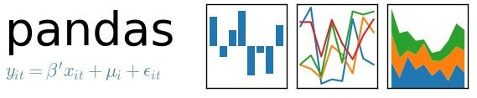

Other libraries and tools

Slide 26
Preparing to code
We will be using Python 3
Recommended: Anaconda (most packages that we need are already bundled in)
Check that your version of these packages are equal to, or newer.
Python 3.5.2
NumPy 1.9.1
SciPy 0.14.0
Scikit-learn 0.15.2
Matplotlib 1.4.0
Pandas 0.15.2
Check by printing the version attribute, e.g. print(np. verison )

Slide 27

Preparing to code
If you do not want any newly installed packages to affect your previous Python work, create a new environment (call it ‘ml’)
>> conda create -n ml numpy cipy matplotlib ipython cikit-learn panda
Include the libraries to make sure your new environment has them installed
>> activate ml
Activate the environment and check...

Slide 28
Go To Exercises

Slide 29
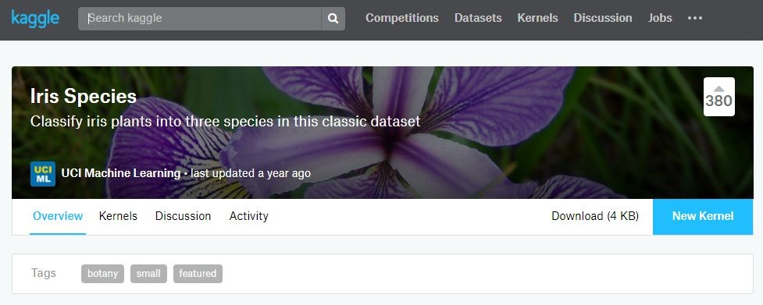
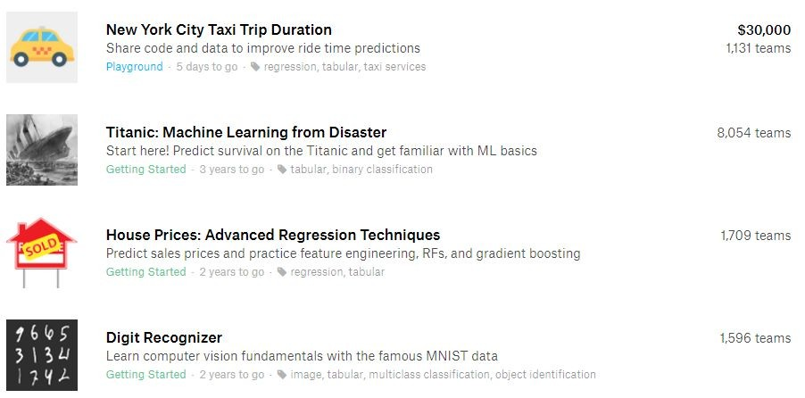
Join Kaggle
Never too late. Challenge yourself. Level up your skills.

Slide 30
Join Kaggle
SIgn up for an account, and look for the Iris Species page.
You can run Python code / create Notebooks in the kernel section

Slide 31
Ending Note
WiFi Password: UFYQU-BQAJH
Thanks to John for the help with the slides.

